Slide 1
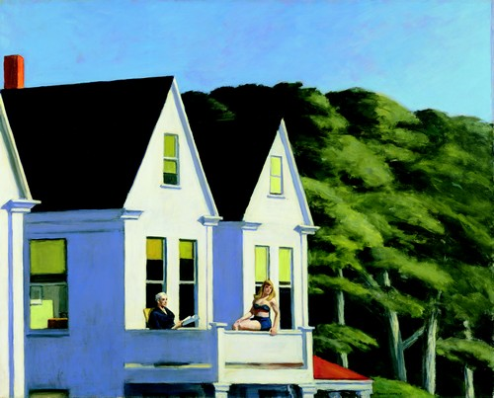
Second Story Sunlight
Soleil au balcon 1960 oil on canvas painted by Edward Hopper 1862-1967
New York Whitney Museum

Slide 2
What type of piece of work is it? (two answers can be accepted)
Note: colors (US), colours(GB)
A photograph- a watercolour =aquarelle- a painting –an oil on canvas
Each color/colour can be associated with an element from the painting:
windows- balcony-trees(leaves and foliage)-roof-indoor curtains- chimney-
tree( trunks )-façades- a row of stylish houses
black-red-dark red- yellow- white -green-violet-black and white -light green- dark green -grey and grey-ish- rainbow colours- mainly primary colours
Who are the characters?
A man and a woman?
A husband and his wife?
A father and his daughter?
Two persons who do not know each other? Who know each other?
Marie André-Milesi Collège Lucie Aubrac de Doubs Académie de Besançon

Slide 4
Palette of words:
Adjectives: silent //lonely//isolated//quiet and adjectives: silent //lonely//isolated//quiet and peaceful//noisy//eternal//pleasant//unpleasant
quiet//sunny//beautiful//calm//strange//eerie
paradisaical =like paradise= the Garden of Eden
threatening
nouns: swimming-costume; sunlight; morning; afternoon; newspaper; magazine; paradise; threat(crainte)
verbs: to read//to bathe in the sun//to have a good time//to have fun//to enjoy oneself//to expect (attendre, s’attendre à)//to hope//to wish//to regret//to offer//
bathe in the sun//to have a good time//to have fun//to enjoy oneself

Slide 5
Prompts or ideas to help you!
What are they looking at? What are they doing?
Write your own story. Style of a thriller or style of your choice.
1)an absence of dialogue and inner thoughts
2) a dialogue between the two characters (questions and answers)

Slide 6
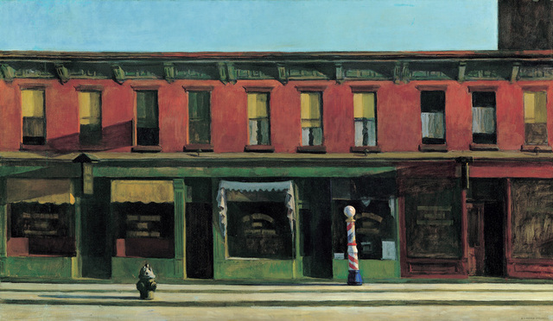
Early Sunday Morning, 1930.

Slide 7
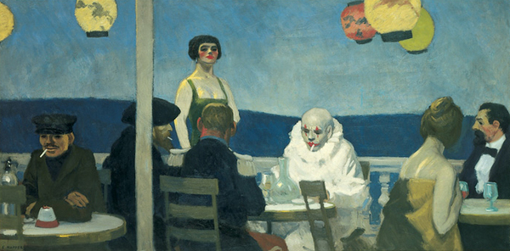
Soir Bleu, 1914. Oil on canvas

Slide 8
Include one to two:
-elements of surprise and suspense :
What a + noun !// How +adjective!
-modals or markers expressing probability or possibility
-modals or markers expressing certainty
-elements expressing regrets and wishes:
I wish I had+ past participle
-elements of satisfaction: How +adjective!
-elements indicating projects in the future
Marie André-Milesi
Collège Lucie Aubrac de Doubs Académie de Besançon

